Slide 1
Spectral Clustering

Slide 2
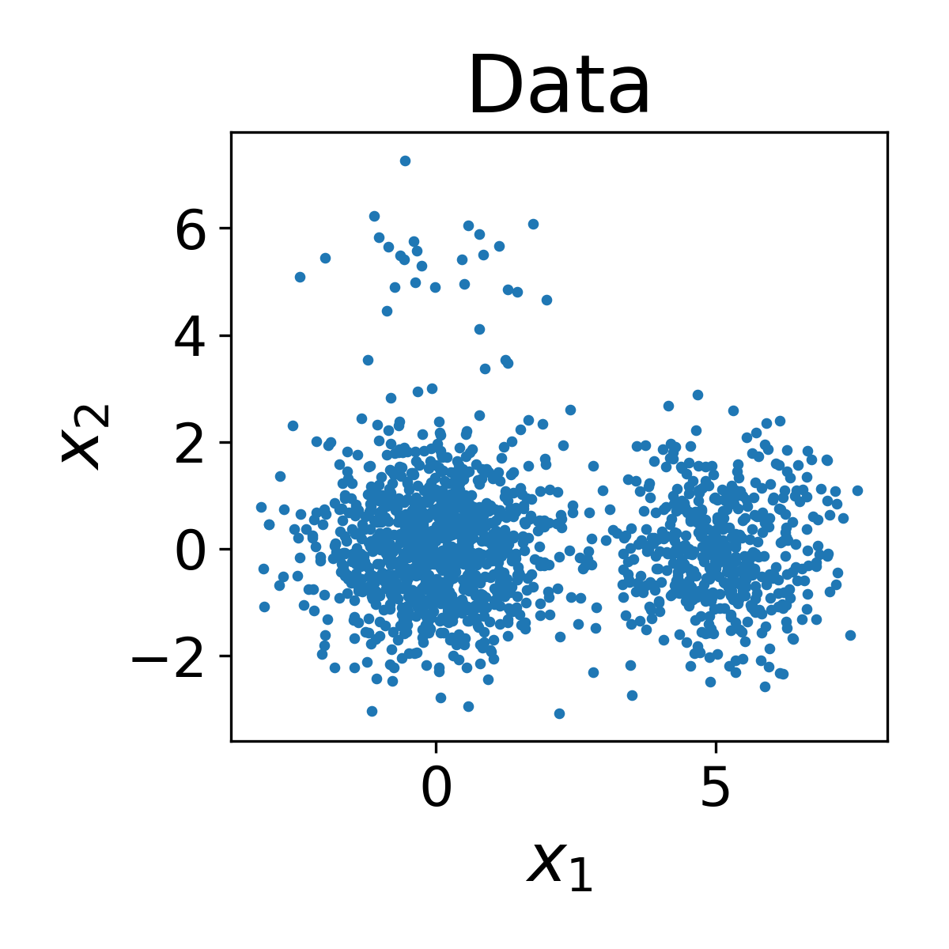
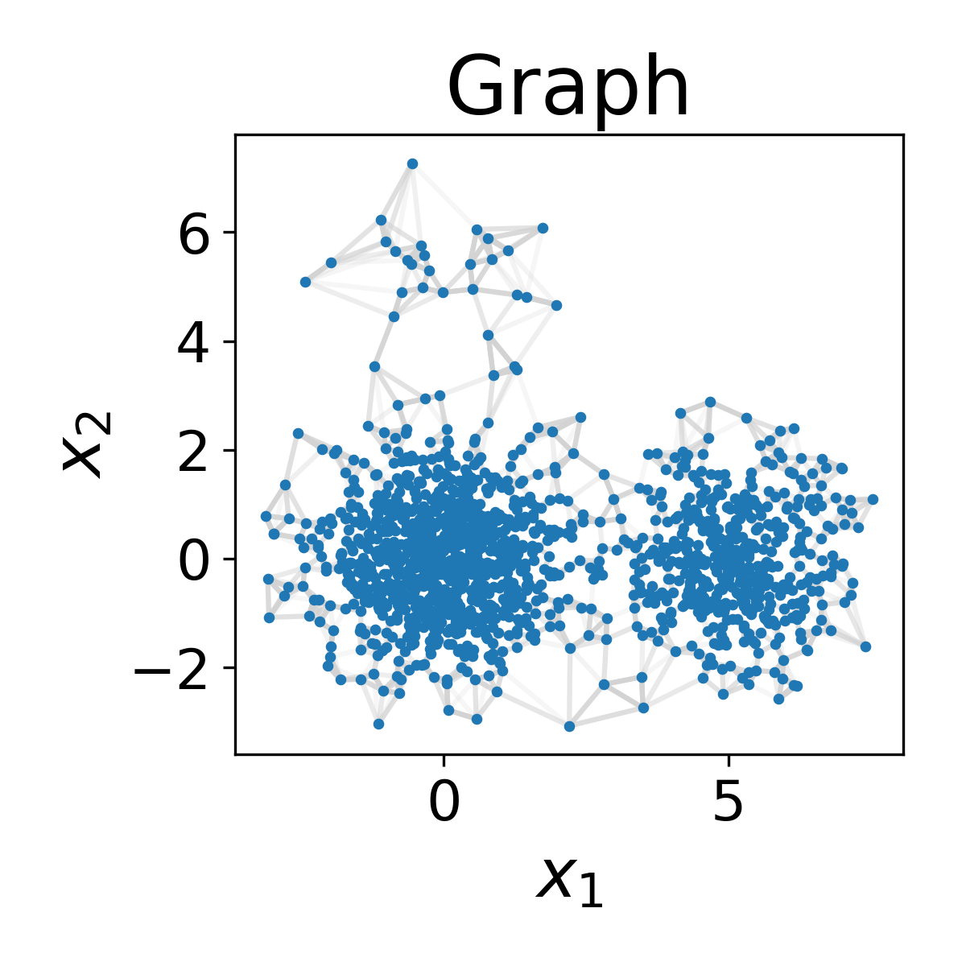
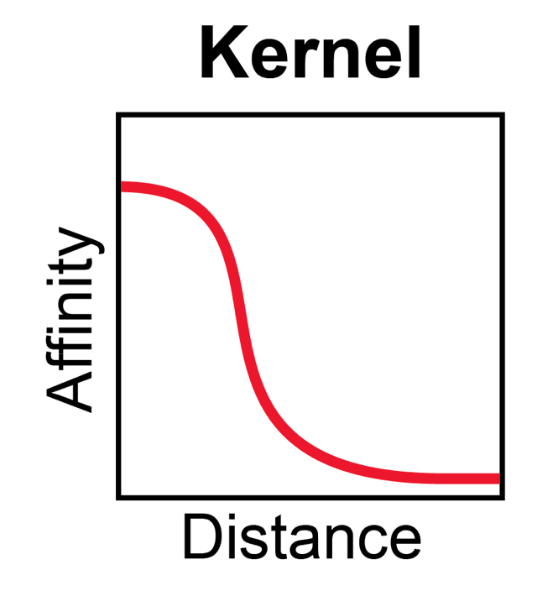
Spectral clustering uses eigenvectors of the graph Laplacian for clustering

Slide 3


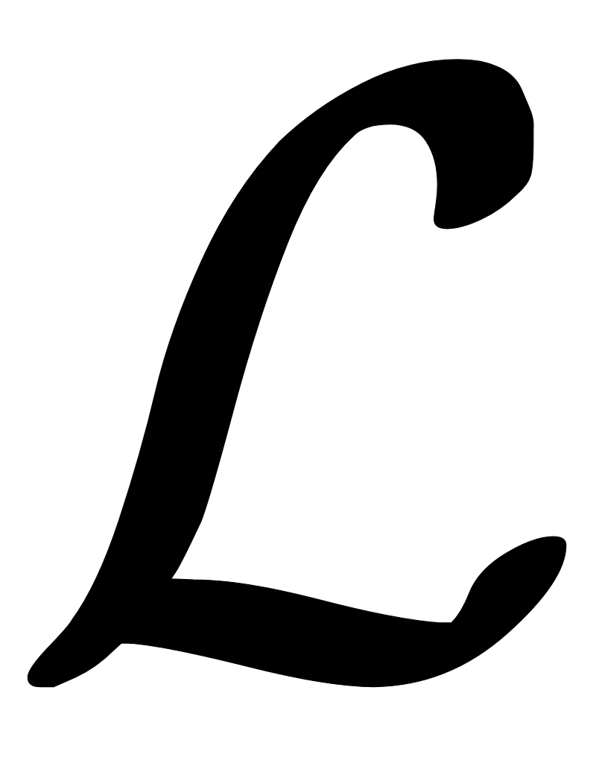

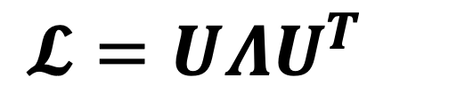

Spectral clustering uses eigenvectors of the graph Laplacian for clustering
= adjacency/affinity matrix
= degree matrix
= Laplacian matrix
$𝓛=UΛU^{T}$
= eigendecomposition
$$U$$
= eigenvectors (graph spectra)

Slide 4
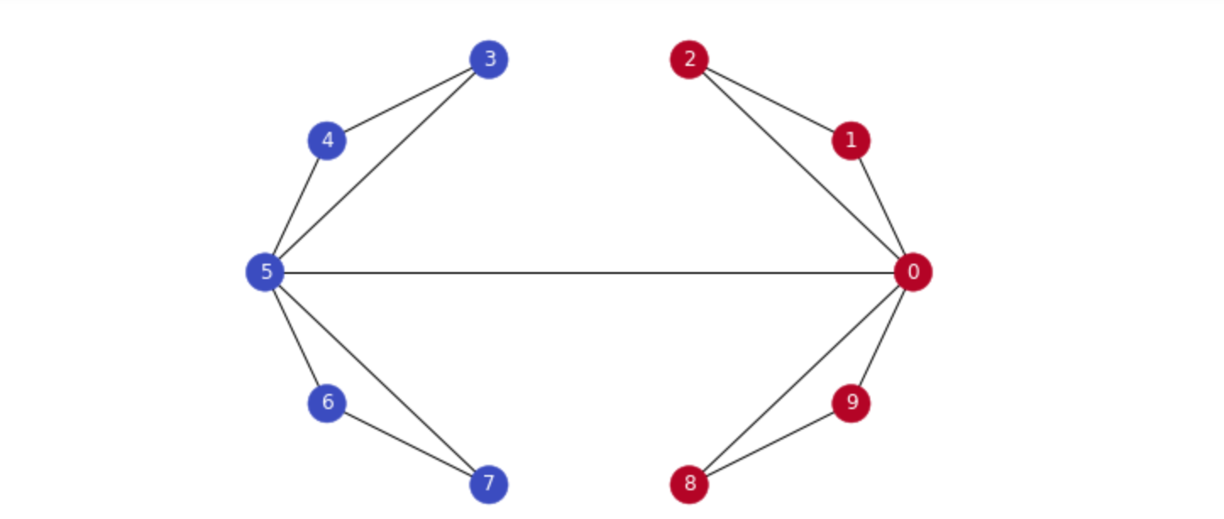
Fiedler Vector
Second-smallest Eigenvalue is called Fiedler value, corresponding vector is the Fiedler vector
Fiedler value := approximates minimum cut needed to partition graph
Vector can be used for partitioning, positive in one partition, negative in another
https://towardsdatascience.com/spectral-clustering-aba2640c0d5b

Slide 5
The multiplicity of the 0 eigenvalue indicates number of connected components in the graph

Slide 6
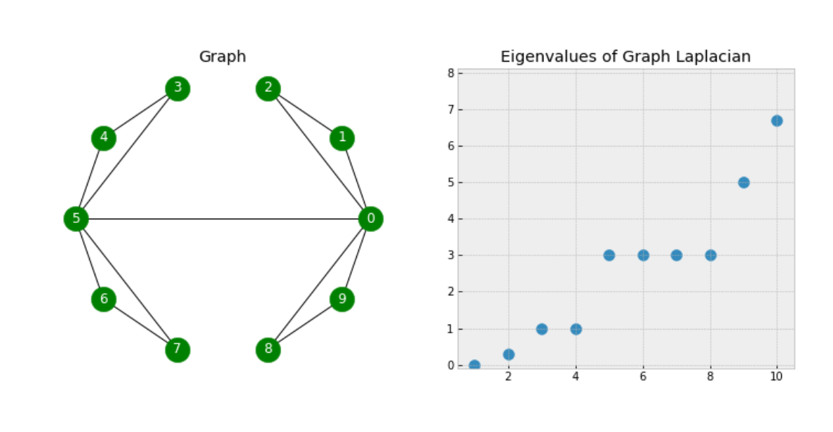
GAP
There is a gap between 4th and 5th values, increases suddenly, indicates that
there are 4 clusters in the graph roughly.

Slide 7
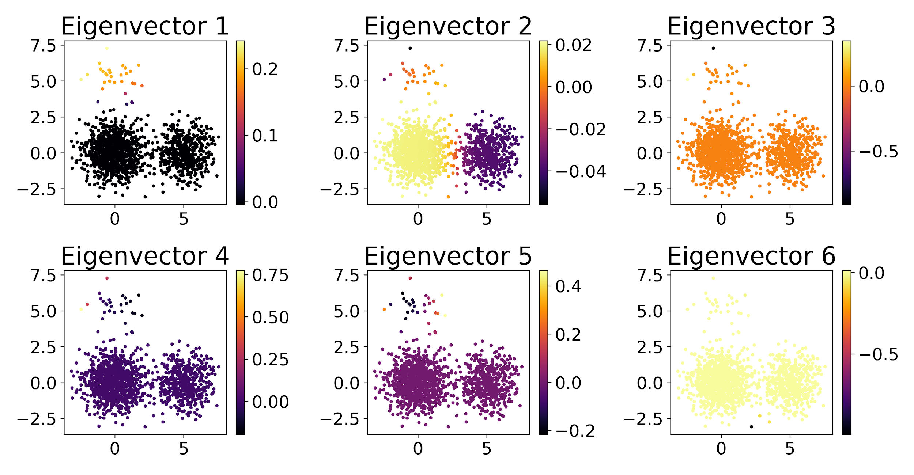
Spectral clustering uses eigenvectors of the graph Laplacian for clustering
Notes:
because eigenvectors of graph laplacian are sensitive to connection in the graph rather than Euclidean distance between data points
that means it tend to put these points that have connection, or are densely connected with each other together into the same clusters,
we can see that when we look at these eigenvectors
first non-trivial eigenvector of graph laplacian
second eigenvector clearly pick the second vector out
the 3rd eigenvector clearly pick the small outlier cluster in left-top corner
these eigenvectors tend to partition data is a natural means by which you can cluster any graph

Slide 8
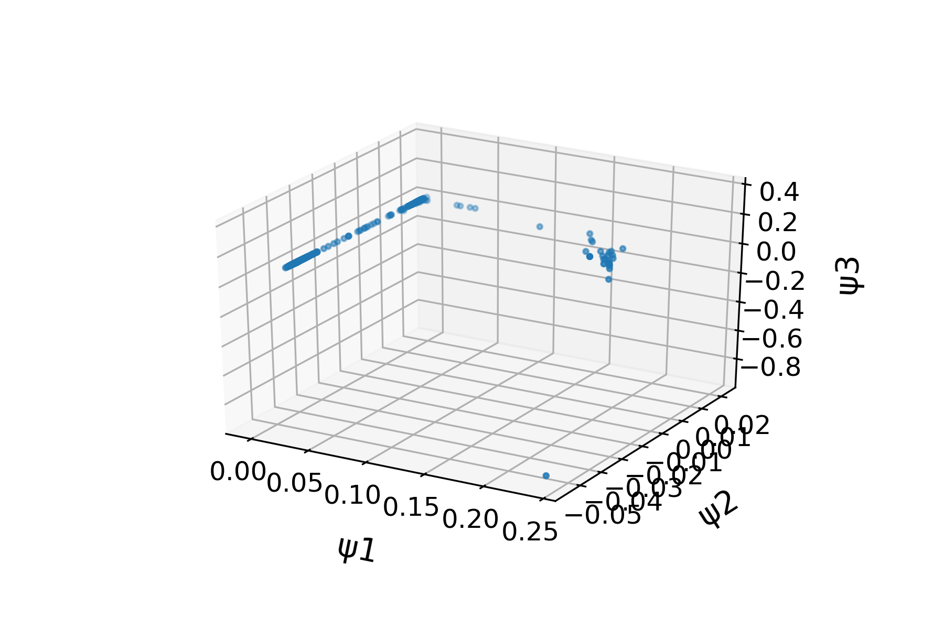
Spectral clustering uses eigenvectors of the graph Laplacian for clustering
Notes:
in spectral clustering, we simply apply k-means but on eigenvectors representation of a graph
3D visualization of these eigenvectors representation of a graph

Slide 9
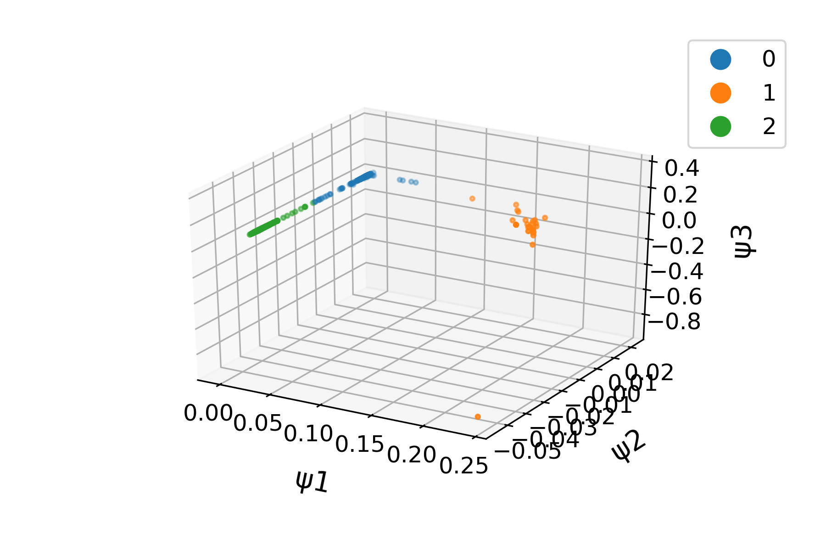
Spectral clustering uses eigenvectors of the graph Laplacian for clustering
KMeans
Notes:
colored by cluster identity
eigenvector 2 separate green from blue cluster
while eigenvector 1 separate orange from rest of clusters

Slide 10
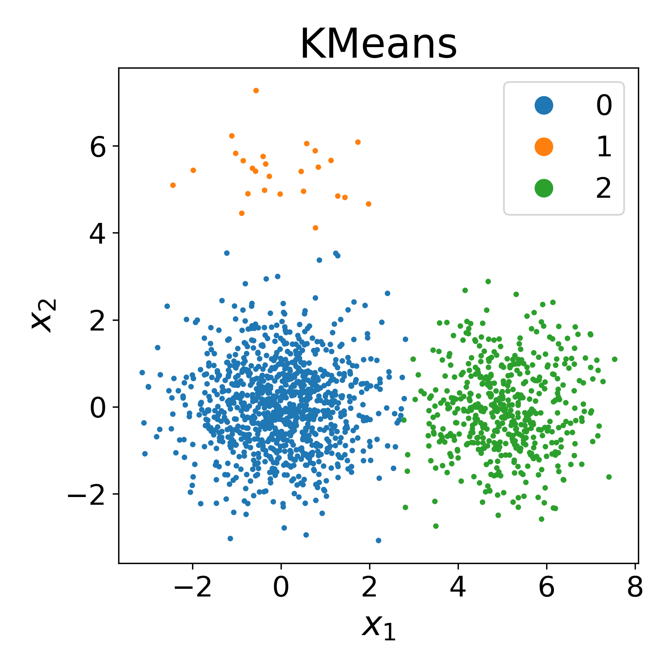
Spectral clustering uses eigenvectors of the graph Laplacian for clustering
Spectral
KMeans

Slide 11
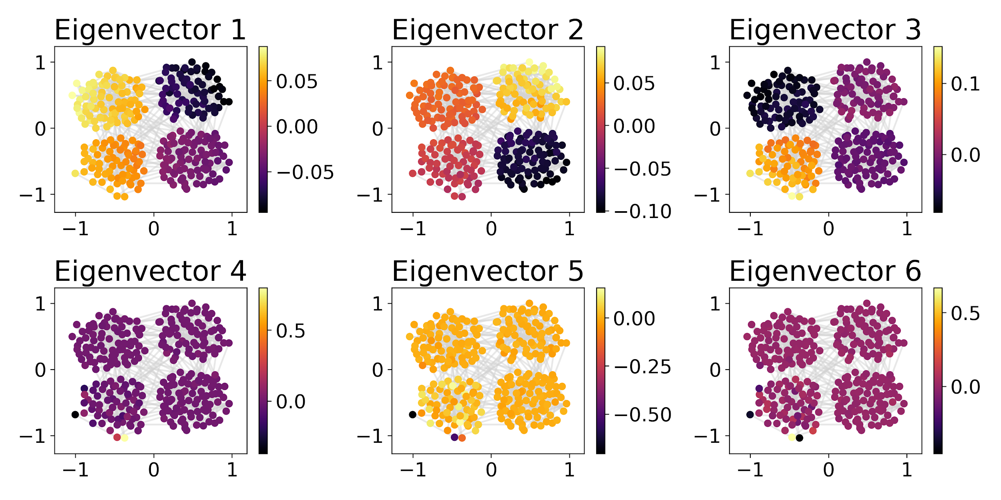
Spectra of various graphs

Slide 12
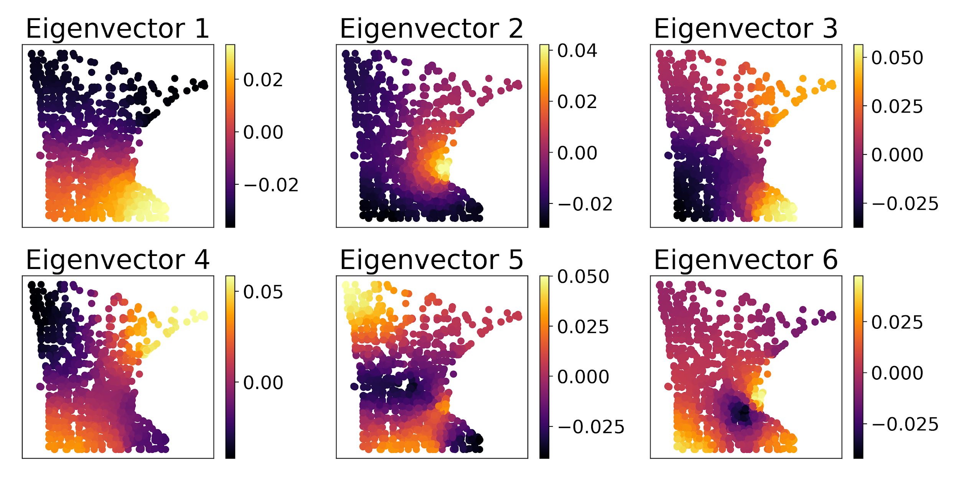
Spectra of various graphs

Slide 13
What are advantages of using the graph spectrum for k-Means?
Good for clusters of arbitrary shape
Good for data that is just a graph
Only need connectivity information!

Slide 14
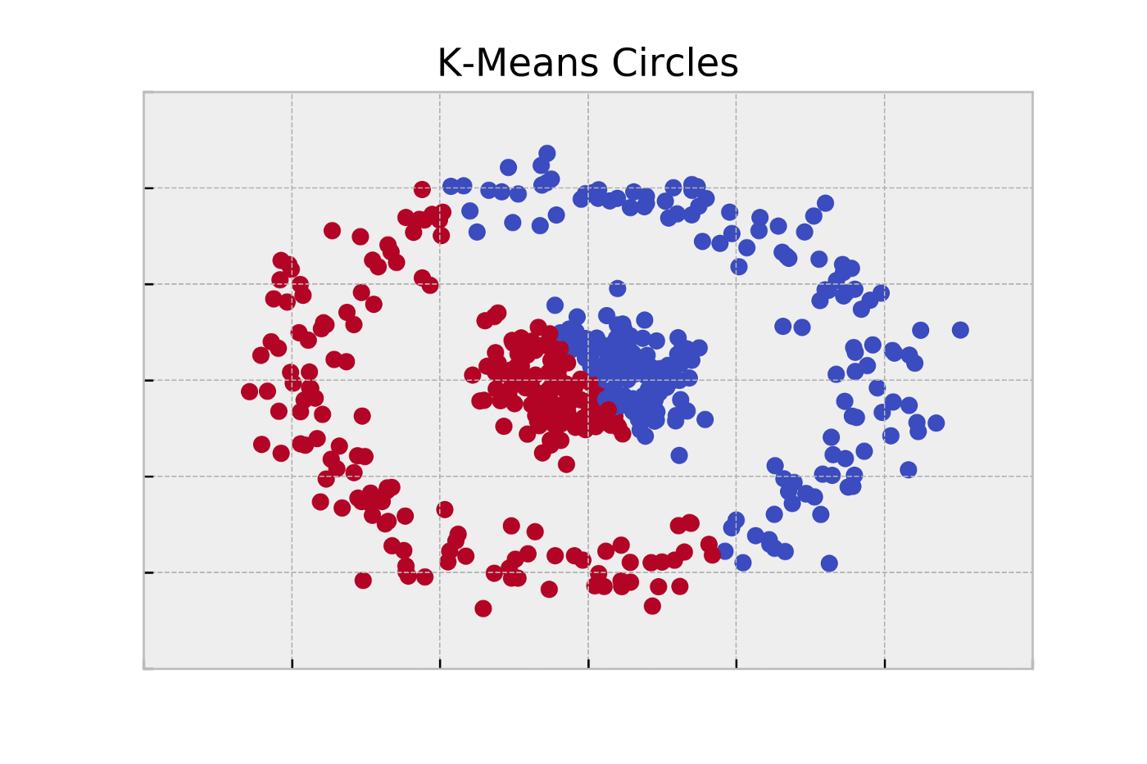
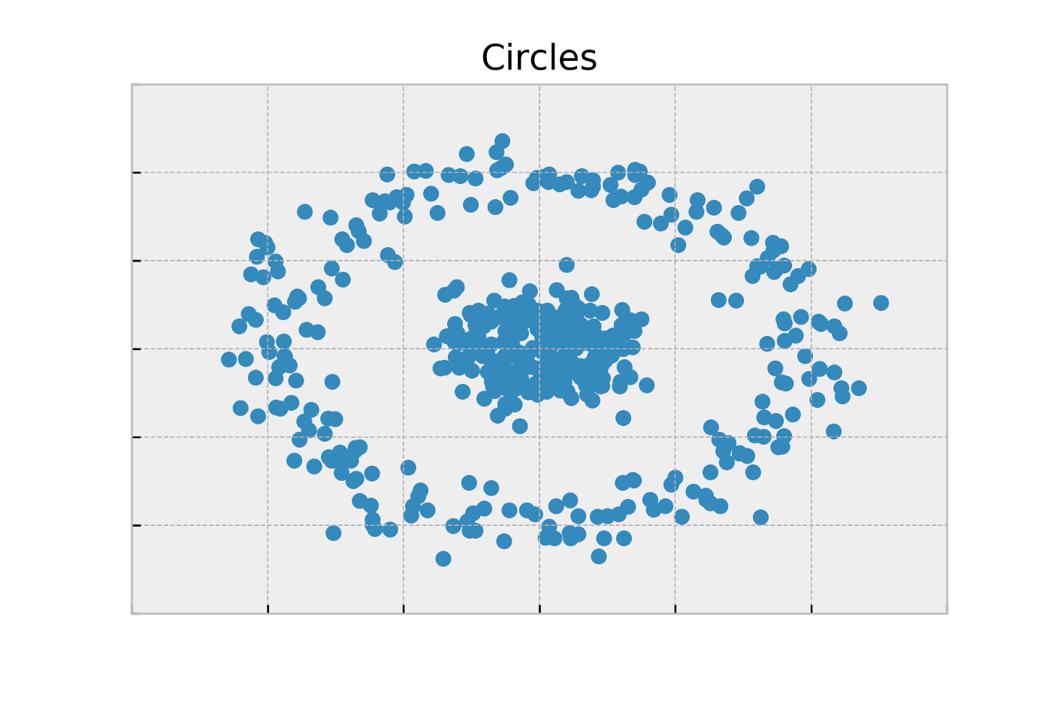
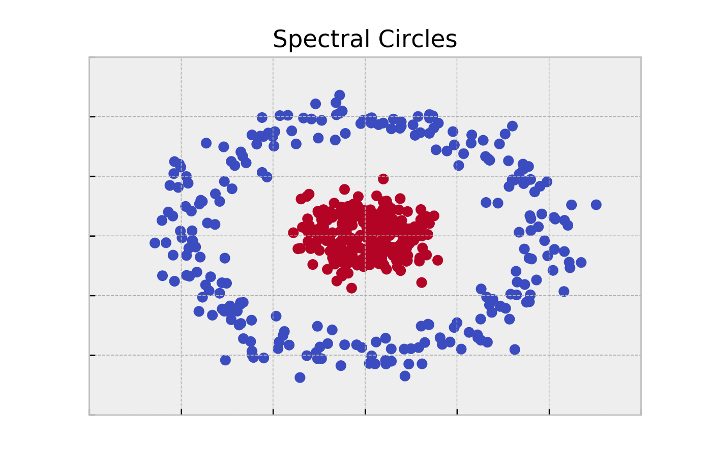
Concentric Circles

Slide 15
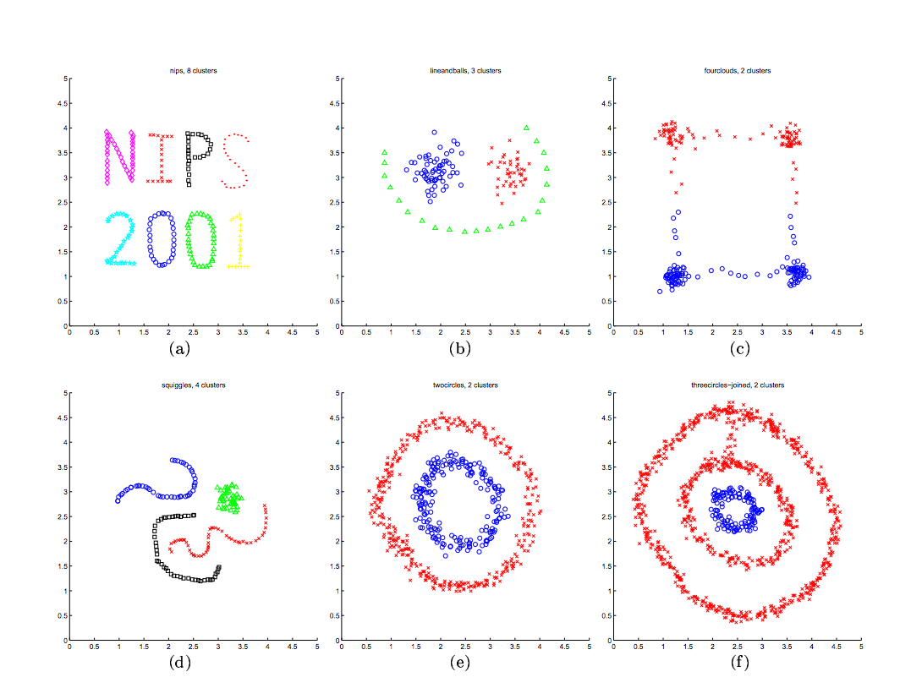

Slide 16
Exercise:
https://colab.research.google.com/github/KrishnaswamyLab/SingleCellWorkshop/blob/master/exercises/Clustering/notebooks/01_Answers_Clustering_Embryoid_Body_Data.ipynb 胚状体
Make synthetic datasets
https://scikit-learn.org/stable/modules/classes.html#module-sklearn.datasets
Blobs
Circles
Try Kmeans with different clusters sizes
Try spectral clustering with different cluster numbers

